Slide 1
JL logo
Home, Projects, Contact
Photoshop awesome cover image
Picture
Hi, I’m Joe
[blurb]
Use scroll/other animation libraries?
About: include services and what I can do, run blog at 1000 Mile World
See my work | Get in touch
Copyright Joe Liang 2020

Slide 2
Project Page
“Promo” pic, perhaps with sliding images if want to show different aspects of project
Project details
Technologies/Skills Involved: HTML5, CSS3 with SASS, UI/UX animations, etc.
Have navigation between project pages, home is all the way to the left and contact all the way to the right

Slide 3
Project list
Design a website for a business, or 2
Possible “clients”: restaurant, clothing store, something with cool animated front page
Twitter/Instagram/Google Maps API
JS Piano keyboard
Pomodoro clock
Whack-a-mole

Slide 4
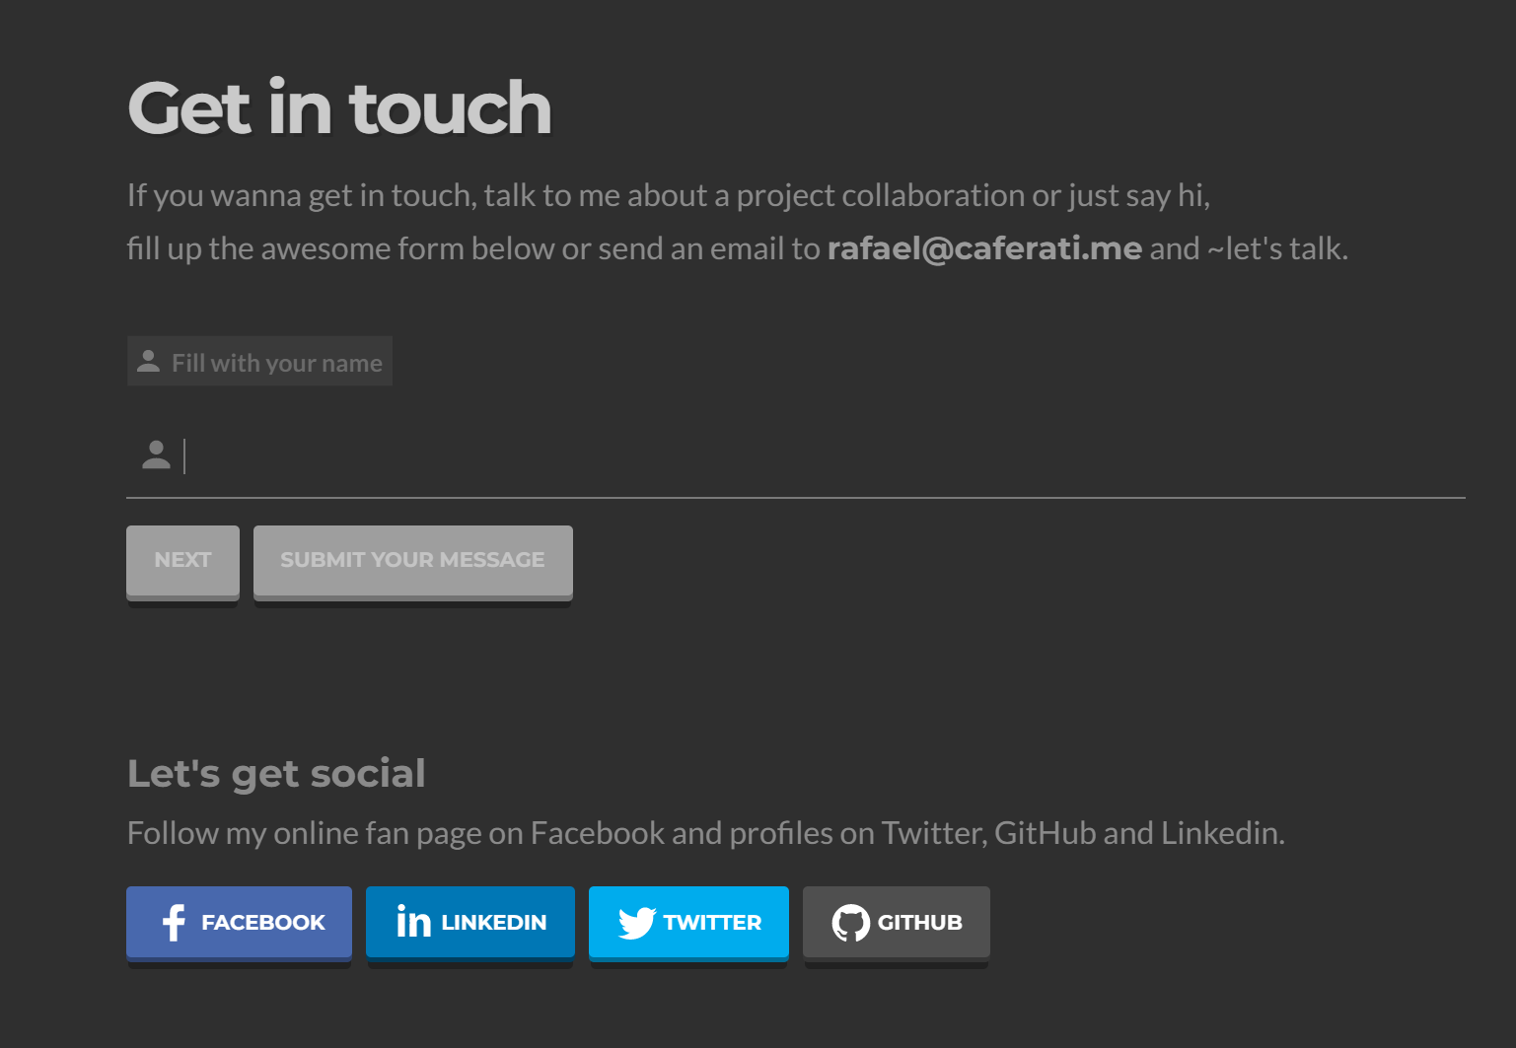
Contact

